Slide 1
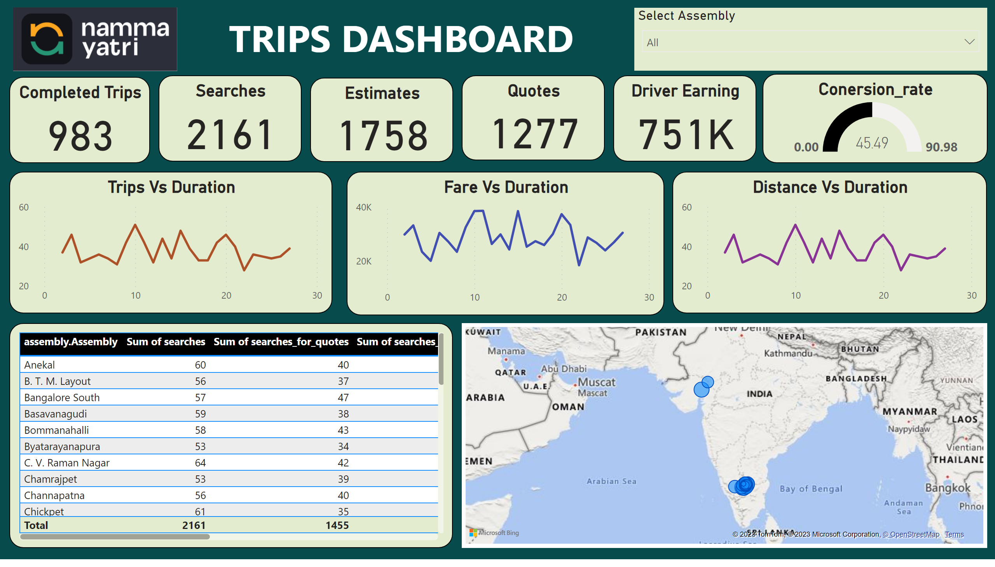
Page 1
Notes:
Completed Trips
No alt text provided
Searches
No alt text provided
Estimates
No alt text provided
Quotes
No alt text provided
Driver Earning
No alt text provided
gauge
No alt text provided
Trips Vs Duration
No alt text provided
Distance Vs Duration
No alt text provided
Fare Vs Duration
No alt text provided
tableEx
No alt text provided
map
No alt text provided
image
No alt text provided
textbox
No alt text provided
Select Assembly
No alt text provided

